Slide 1
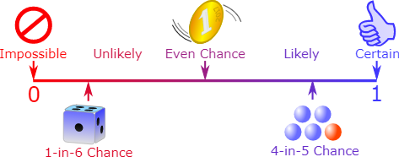
MATHS-MINIPROJECT
Academic Year: 2022-23 March 2023
SE_COMPS (C6)
Group members:
58-Noel Sangle
41-Gaurav Mishra
52-Merwin Rebello
65-Aditya Singh
66-Sahil Singh
Probability

Slide 2
INTRODUCTION
By performing this experiment, we are going to record the number of heads which we will receive by tossing 7 fair coins simultaneously for a trial, where there will 5 such trails of tossing 7 coins and then we will plot a graph of count vs frequency for the demanded values which we are going to discuss about them as we move further in our presentation. At last we will observe the graphs which have been plotted and they will provide us with the required conclusion. Further we will discuss the probability distributions which where used in this project.

Slide 3
Binomial Distribution: The binomial distribution is the basis for the popular binomial test of statistical significance. The binomial distribution is frequently used to model the number of successes in a sample of size n drawn with replacement from a population of size N. If the sampling is carried out without replacement, the draws are not independent and so the resulting distribution is a hypergeometric distribution, not a binomial one. However, for N much larger than n, the binomial distribution remains a good approximation, and is widely used.
Normal Distribution: The graph we obtained from the experiment of tossing 7 fair coins simultaneously and recording the number of heads is not a normal distribution. A normal distribution has a bell-shaped curve that is symmetric around its mean, and the probability density function of a normal distribution is given by the bell-shaped equation known as the Gaussian function.
Therefore, even though the distribution of the number of heads we obtained is not a normal distribution, as the number of trials increases, the distribution becomes more normal-like, which is why we often use the normal distribution as an approximation for many practical purposes.

Slide 4
PROBLEM STATEMENT
Toss 7 fair coins simultaneously.
Record the number of heads.
Perform 5 trials of this process of tossing 7 coins.
Step 1: Record the number of heads you received in each trial - that is, Count.
Step 2: Draw the graph of Count vs frequency for all the trials put together.
Now perform 10 trials of this process of tossing 7 coins.
Repeat Steps 1 and 2.
Increase the number of trials to 20, 30, 40, · · ·, 100, 200, · · · , 1000, · · · Repeat Steps 1 and 2 in each case.
What do you observe?- Can you identify the distribution?

Slide 5
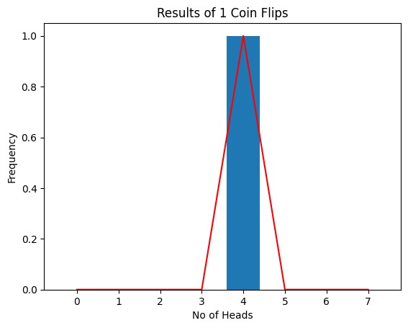
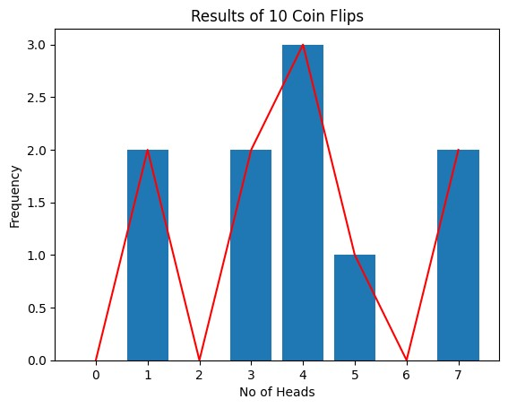
Below are the graphs obtained from the data analysis
Number of trials 1: Number of trials 10:

Slide 6
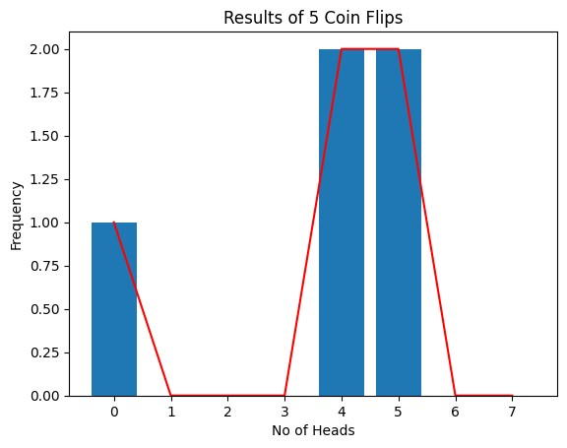
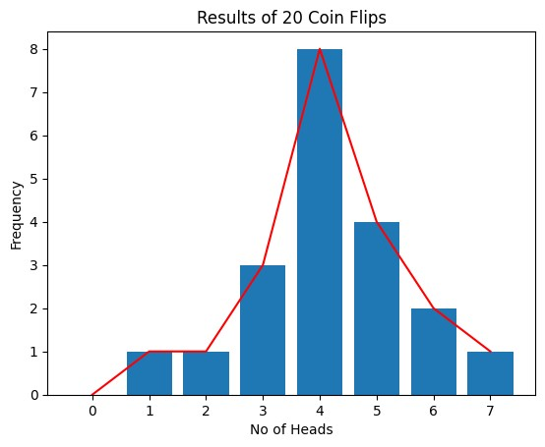
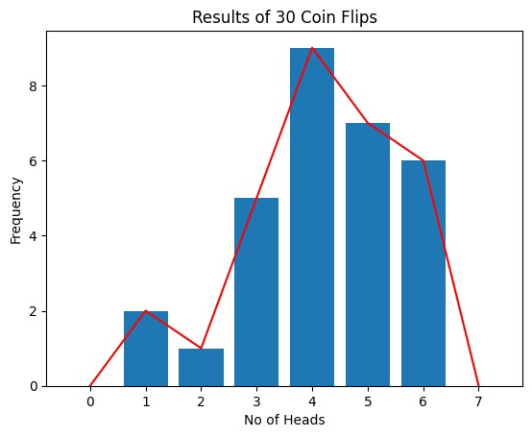
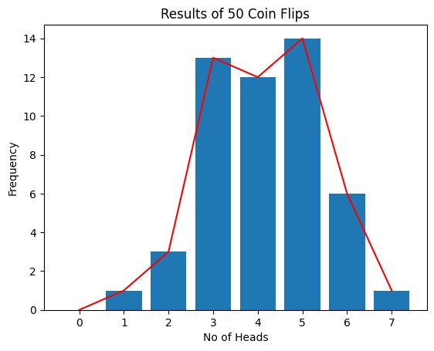
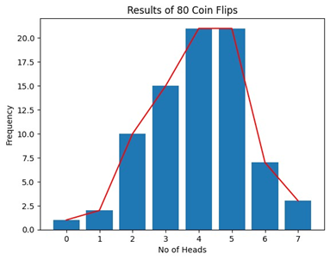
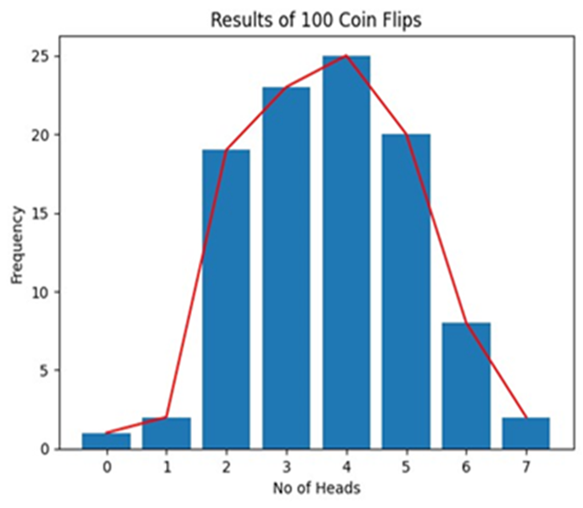

Slide 7
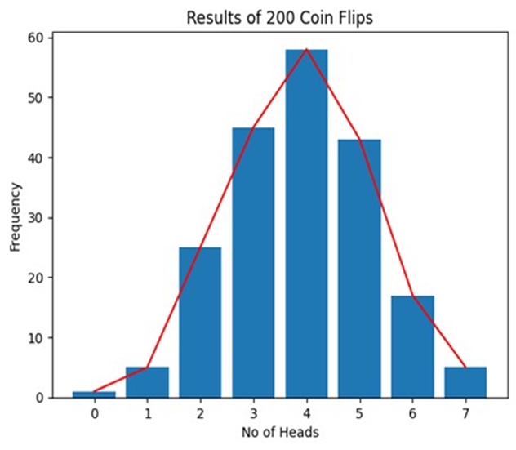
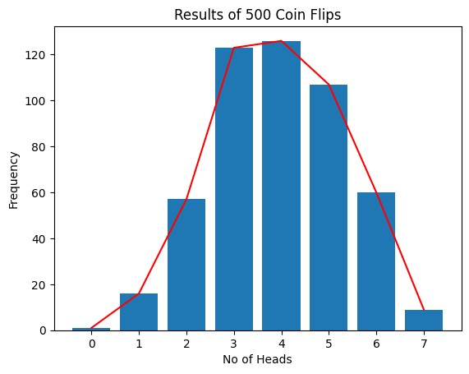
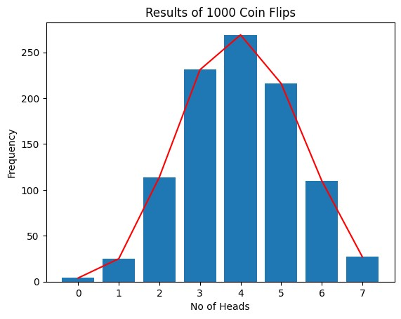
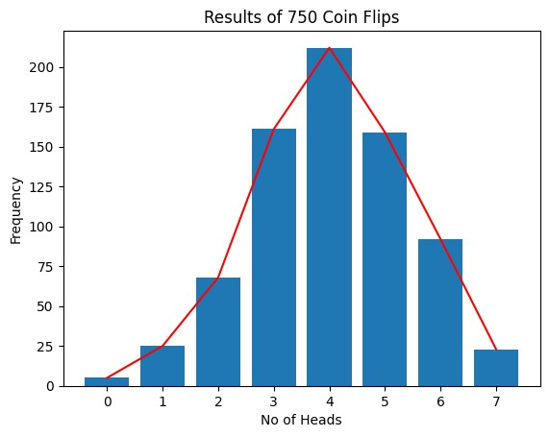


Slide 8
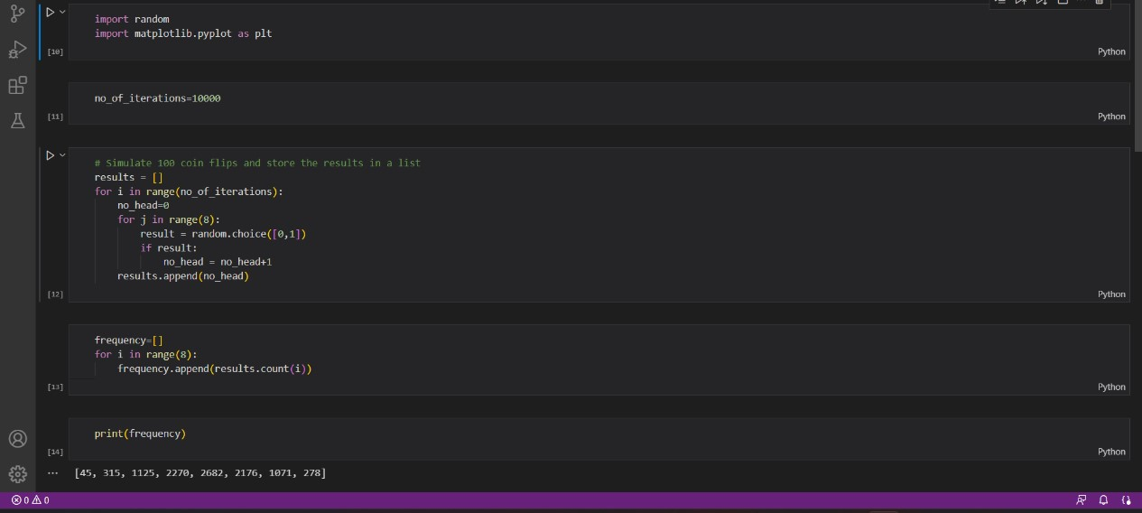
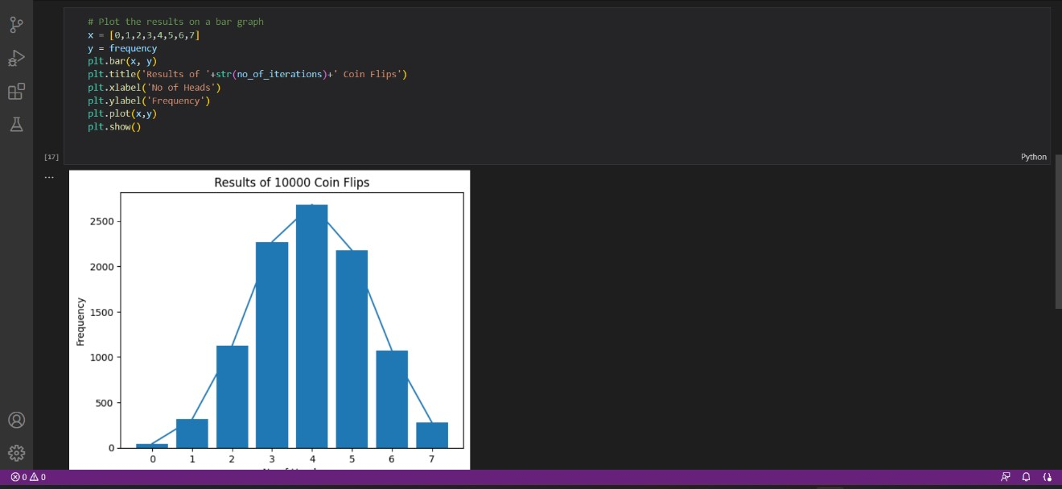
CODE USED

Slide 9
Conclusion
The experiment of tossing 7 fair coins simultaneously and recording the number of heads follows a binomial distribution. The binomial distribution describes the number of successes (heads) in a fixed number of independent trials (coin tosses), where each trial has the same probability of success (probability of getting heads).
As we perform more and more trials of tossing 7 coins, we should expect to see the frequency distribution of the number of heads approach the binomial distribution. Specifically, the mean of the distribution should be equal to the expected number of heads, which is 7/2 = 3.5, and the variance of the distribution should be equal to the expected variance of the binomial distribution, which is np(1-p), where n is the number of trials (7 in this case) and p is the probability of success (0.5 in this case).
As we increase the number of trials, we should observe that the histograms become more and more peaked around the expected value of 3.5, and the spread of the distribution becomes narrower and narrower. This is consistent with the expected behavior of the binomial distribution.
In summary, the experiment of tossing 7 fair coins simultaneously and recording the number of heads follows a binomial distribution. As we perform more and more trials, we should observe that the frequency distribution of the number of heads converges towards the expected binomial distribution with a mean of 3.5 and a variance of 7/4.

Slide 10
Thank you

